Slide 1
Support Vector Machines (SVM)

Slide 2
SVM — Introduction
Support vector machines (SVMs) are a set of related supervised learning methods used for classification and regression
A support vector machine constructs a hyperplane or set of hyperplanes in a high-dimensional space, which can be used for classification, regression or other tasks.

Slide 3
SVM—Introduction
SVM applicable for both linear and nonlinear data
It uses a nonlinear mapping to transform the original training data into a higher dimension
With the new dimension, it searches for the linear optimal separating hyperplane (i.e., “decision boundary”)
With an appropriate nonlinear mapping to a sufficiently high dimension, data from two classes can always be separated by a hyperplane
SVM finds this hyperplane using support vectors (“essential” training tuples) and margins (defined by the support vectors)

Slide 4
SVM—History and Applications
SVMs were originally proposed and introduced by Boser, Guyon and Vapnik in 1992 and gained increasing popularity in late 1990s.
SVMs are currently among the best performers for a number of classification tasks ranging from text to genomic data.
Four basic concepts in SVM: (i) the separating hyperplane, (ii) the maximum-margin hyperplane, (iii) the soft margin and (iv) the kernel function.
The idea of SVM is to map the training data into higher dimensional feature space and constructing a separating hyperplane with maxim margin there.
SVMs used both for classification and prediction
Applications:
handwritten digit recognition, object recognition, speaker identification, benchmarking time-series prediction tests

Slide 5

SVM: Linear Separators
Which of the linear separators is optimal?

Slide 6
SVM - Maximum Margin
α
x
f
y^{est}
f(x,w,b) = sign(w x + b)
denotes +1
denotes -1
The maximum margin linear classifier is the linear classifier with the maximum margin. This is the simplest kind of SVM (Called an LSVM)
Support Vectors are those datapoints that the margin pushes up against
Linear SVM

Slide 7
SVM - Support Vectors
Separator is determined by a subset of the datapoints.
Datapoints in this subset are called “support vectors”.
It will be useful computationally if only a small fraction of the datapoints are support vectors
The support vectors are indicated by the circles around them.

Slide 8
SVM- Linear Separators
Binary classification can be viewed as the task of separating classes in feature space:
w^{T}x + b = 0
w^{T}x + b > 0
w^{T}x + b < 0
f(x) = sign(w^{T}x + b)

Slide 9
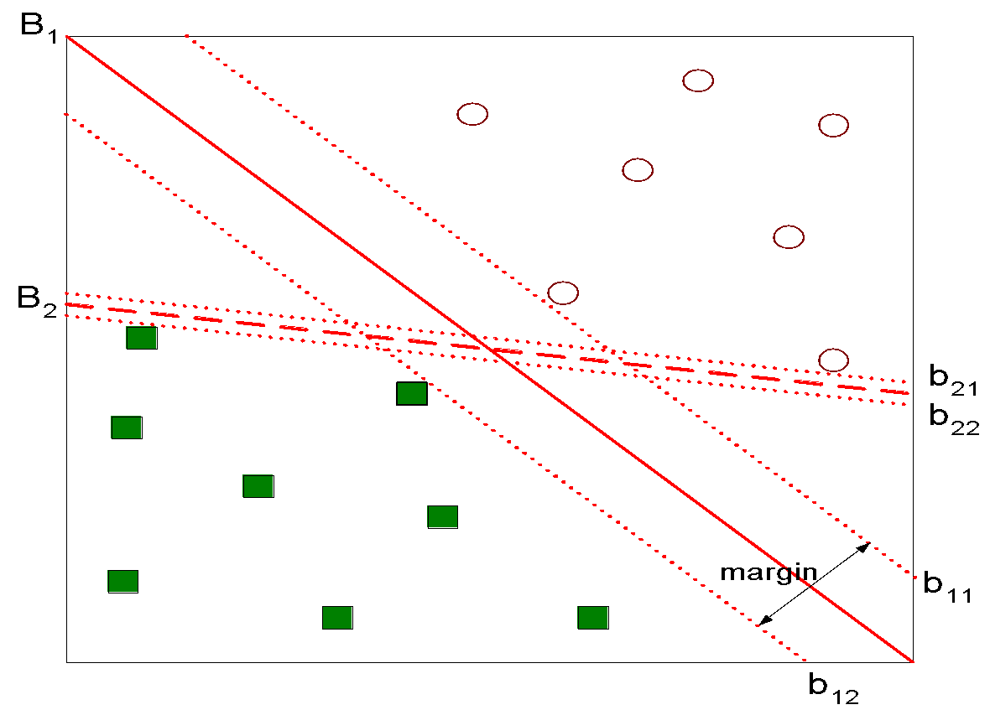
SVM: Hyperplane
Find hyperplane maximizes the margin => B1 is better than B2

Slide 10
SVM—General Philosophy
Small Margin
Large Margin
Support Vectors

Slide 11
SVM — Linearly Separable
A separating hyperplane can be written as
W ● X + b = 0
where W={w₁, w₂, …, w_{n}} is a weight vector and b a scalar (bias)
For 2-D it can be written as
w₀ + w₁ x₁ + w₂ x₂ = 0
The hyperplane defining the sides of the margin:
H₁: w₀ + w₁ x₁ + w₂ x₂ ≥ 1 for y_{i} = +1, and
H₂: w₀ + w₁ x₁ + w₂ x₂ ≤ – 1 for y_{i} = –1
Any training tuples that fall on hyperplanes H₁ or H₂ (i.e., the sides defining the margin) are support vectors
This becomes a constrained (convex) quadratic optimization problem: Quadratic objective function and linear constraints 🡪 Quadratic Programming (QP) 🡪 Lagrangian multipliers

Slide 12
SVM- Maximum Marginal Hyperplane (MMH)
m
Let data D be (X₁, y₁), …, (X_{|D|}, y_{|D|}), where X_{i} is the set of training tuples associated with the class labels y_{i}
There are infinite lines (hyperplanes) separating the two classes but we want to find the best one (the one that minimizes classification error on unseen data)
SVM searches for the hyperplane with the largest margin, i.e., maximum marginal hyperplane (MMH)

Slide 13
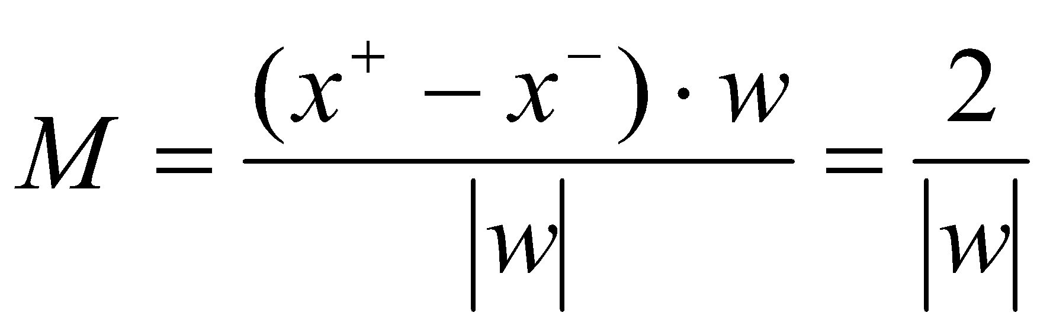
Linear SVM Mathematically
x⁺
M=Margin Width
“Predict Class = +1” zone
X⁻
wx+b=1
“Predict Class = -1” zone
wx+b=0
wx+b=-1
What we know:
w . x⁺ + b = +1
w . x⁻ + b = -1
w . (x⁺-x⁻⁾ = 2

Slide 14
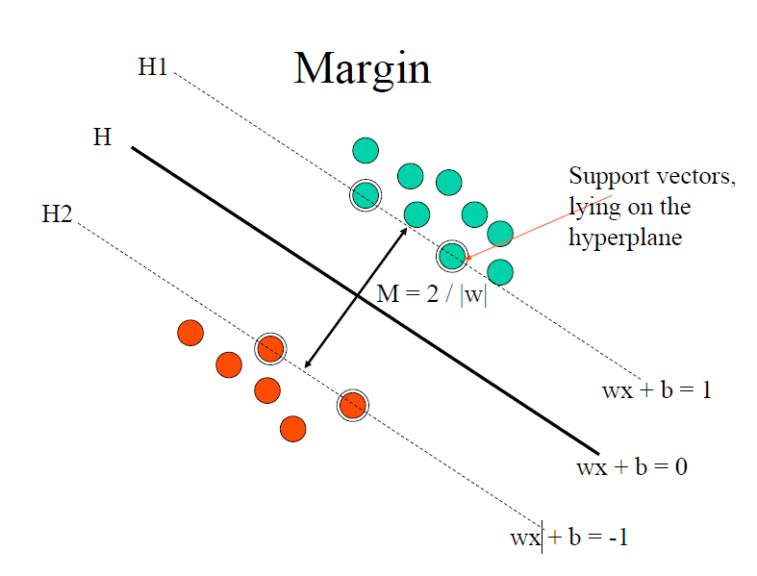

Slide 15
SVM : Non linearly Separable Data
What about non linearly separable data ?
• Most of real data are not linearly separable
• Forcing separation of the data ! overfitting
• Noisy data and outliers.
We need two more steps:
1. Soft margin SVM
2. Kernels

Slide 16
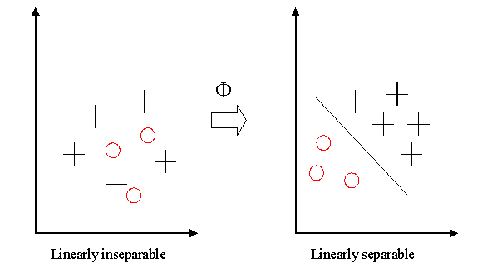
SVM : Non linearly Separable Data
In real world problem it is not likely to get an exactly separate line dividing the data within the space. And we might have a curved decision boundary.
What if the training set is not linearly separable? Slack variables ξi can be added to allow misclassification of difficult or noisy examples, resulting margin called soft margin.
Kernel: If datasets are inseparable. To allow for this kernels are used to non-linearly map the input data to a high-dimensional space. The new mapping is then linearly separable
This mapping is defined by the Kernel:

Slide 17
SVM : Non linearly Separable Data
General idea: the original input space can always be mapped to some higher-dimensional feature space where the training set is separable:
Φ: x → φ(x)

Slide 18
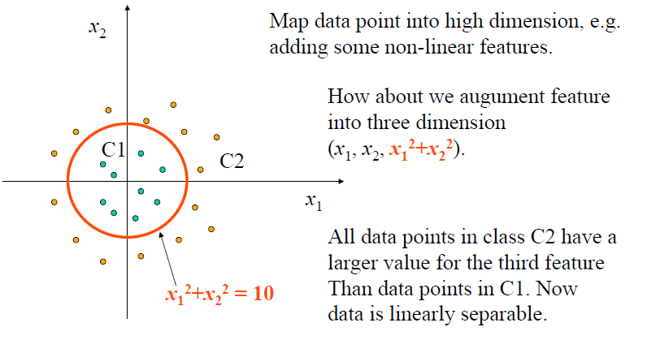
SVM : Non linearly Separable Data

Slide 19
SVM - Soft Margin Classification
What if the training set is not linearly separable?
Slack variables ξi can be added to allow misclassification of difficult or noisy examples, resulting margin called soft.
The method introduces slack variables, ξi, which measure the degree of misclassification of the datum xi
ξ_{i}
ξ_{i}

Slide 20
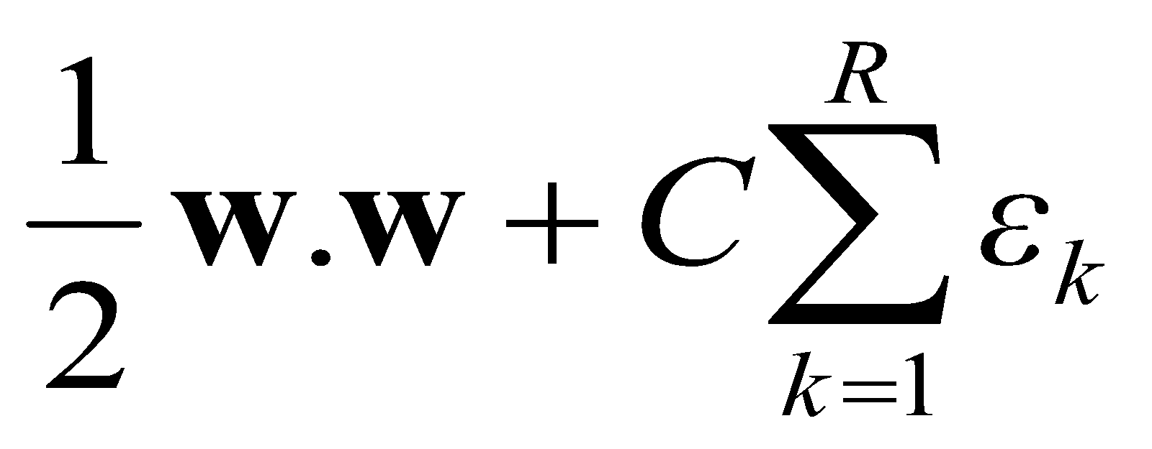
SVM-Soft Margin Classification
Slack variables ξi can be added to allow misclassification of difficult or noisy examples.
ε₁₁
What should our quadratic optimization criterion be?
Minimize
ε₂
wx+b=1
ε₇
wx+b=0
wx+b=-1
Parameter C can be used to control over fitting.

Slide 21
Hard Margin vs. Soft Margin
The old formulation:
The new formulation incorporating slack variables:
Parameter C can be viewed as a way to control overfitting.
Find w and b such that
Φ(w) =½ w^{T}w is minimized and for all {(x_{i} ,y_{i})}
y_{i} (w^{T}x_{i} + b) ≥ 1
Find w and b such that
Φ(w) =½ w^{T}w + CΣξ_{i} is minimized and for all {(x_{i} ,y_{i})}
y_{i} (w^{T}x_{i} + b) ≥ 1- ξ_{i} and ξ_{i} ≥ 0 for all i

Slide 22
SVM - The “Kernel Trick”
Given a kernel function
Transform the data to a high-dimensional space
Find the class boundary with the maximal separation
Only support points are used during operation

Slide 23
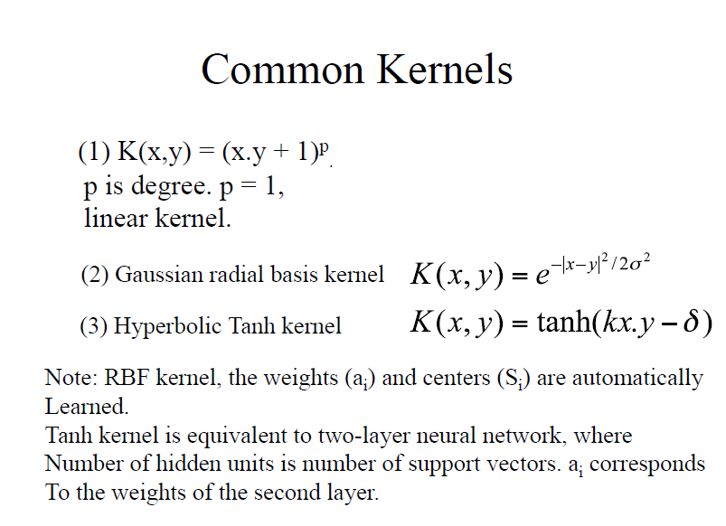

Slide 24
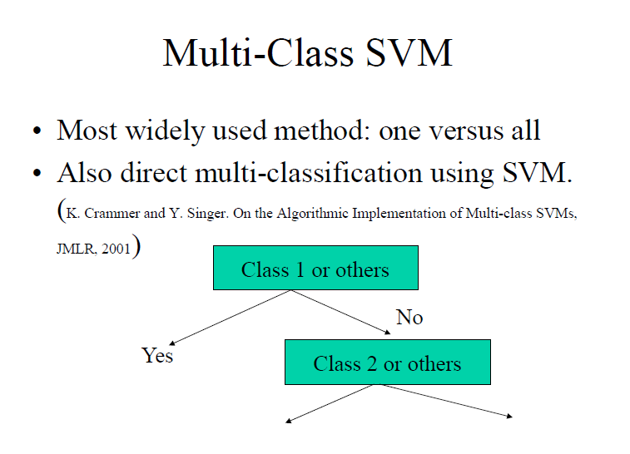

Slide 25
SVM — Reference
“Statistical Learning Theory” by Vapnik: extremely hard to understand, containing many errors too.
C. J. C. Burges. A Tutorial on Support Vector Machines for Pattern Recognition. Knowledge Discovery and Data Mining, 2(2), 1998.
The book “An Introduction to Support Vector Machines” by N. Cristianini and J. Shawe-Taylor
The neural network book by Haykins
Contains one nice chapter of SVM introduction

